Slide 1
New COR® Standard:
Guidelines, Evidence & Scoring
35 MacDonald Avenue
Dartmouth, NS, B3B 1C6

Slide 2
About CSNS
Construction Safety Nova Scotia (CSNS) is an industry funded not-for-profit association focused on improving occupational health and safety in the construction sector.
All companies with a current WCB account under the construction industry classification codes 4011-4499 and 3551 are automatically members due to the levies they pay to the WCB.

Slide 3
Member Benefits
Discounted training (classroom, virtual, online, on-demand at your site)
First year of Certificate of Recognition (COR) audit and COR training FREE!
Free consulting services from our highly-skilled OHS Advisors
Downloadable and customizable templates

Slide 4
CONNECT WITH US
1-800-971-3888 or 1 (902) 468-6696
info@constructionsafetyns.ca
Head office:
35 MacDonald Ave., Dartmouth, NS
Cape Breton office:
850 Grand Lake Road, suite 16,
Sydney, NS
(at the firehall)
Construction Safety Nova Scotia
ConstructionSafetyNS
@ConstrSafetyNS
ConstructionSafetyNS
www.constructionsafetyns.ca

Slide 5
CSNS Transition Approach
September 1, 2023
Members have an option of a one-time choice in 2023, of using old vs new COR® audit instrument for internal audits. External audits will be conducted using the new COR® audit instrument
January 1, 2024
All companies must use the new COR® audit instrument

Slide 6
Webinar Outline
Overview of required information
Guidelines
Scoring Table
Observation Table
Interview Table
Summary Score Table
Q & A

Slide 7
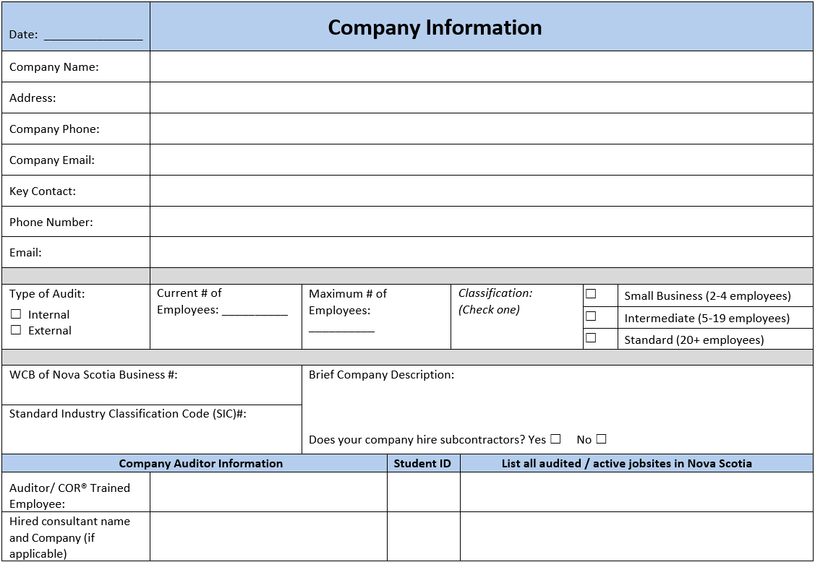

Slide 8
COR® Audit Instrument Guidelines
2.0 | Guidelines - Hazard Assessment, Analysis, and Control
Small Business- All questions apply
2.1 | An employer is required to complete formal hazard assessments that encompass all aspects of company operations, including both routine tasks and non-routine work. Hazard assessments could also include primary scopes of work undertaken by the company, task inventories, or occupational exposures. The hazard assessments should be based on the work performed and should result in the identification of hazards and implementation of control measures. - Award two (2) points based on documentation of completed formal hazard assessments as per company policy/directive. - Award three (3) points based on observations that the formal hazard assessments accurately reflect the activities on site and are made readily available. - Award two (2) points based on the majority of positive interview responses.
2.2 | Completed hazard assessments must clearly report/describe existing and potential hazards and the majority of interview responses must confirm workers review of the information on hazard assessments. Both documentation and interviews must be confirmed to award points.
2.3 | Completed hazard assessments must show that risks are assessed/evaluated prior to work being performed. An example of an assessment/evaluation could include hazard ranking using frequency, severity, or probability ranking.
2.4 | Documentation must show that risks on hazard assessments are reassessed/re-evaluated when people, equipment, material, environment, or processes are changed. The frequency of this type of assessment will depend on how often changes occur. The hazard assessment commonly used before each day, or each task, is a good example of an ongoing risk assessment process. - Award three (3) points based on documentation of completed ongoing risk assessments from the same worksite location as applicable. - Award three (3) points based on the majority of positive interview responses.
2.5 | Documented hazard assessments must include consideration of design and layout of the work area, ergonomics, machinery, or processes to award points for this section. The risk of musculoskeletal injury and appropriate prevention control (safe job procedures, tailored work schedules, personal protective equipment, etc.) would be an example for awarding points.
2.6 | The names of the individuals involved in hazard assessments must be identified in the documentation. On-site workers, supervisors, and any other individual involved must be identified in the hazard assessment process. - Award two (2) points based on verification of appropriate signatures on completed hazard assessments. - Award two (2) points based on the majority of positive interview responses.

Slide 9
COR Audit Instrument Guidelines
2.7 | Verify training has been completed for individuals involved in the hazard assessment to confirm their competency. - Award two (2) points based on verification of training for individuals identified on completed hazard assessments. - Award two (2) points based on the majority of positive interview responses of those responsible.
2.8 | Verify a critical task list has been completed (a list of tasks involving the potential for serious injury or death — for which related safe job procedures should be developed). Points may also be awarded if critical tasks are identified on completed hazard assessments as well as having the applicable safe work procedure included as the control.
2.9 | Once hazards are identified, appropriate controls must be put in place. Verify the methods of control follow the hierarchy of controls (elimination, substitution, engineering controls, administrative controls, personal protective equipment). Verify through documentation showing hierarchy of controls was used to determine the appropriate control method. Points may also be awarded by verifying workers are following the controls identified on the hazard assessment for the job/task.
2.10 | Verify through documentation and interviews that appropriate individuals/roles are assigned the responsibility to implement the control. Both documentation and interviews must be confirmed to award points.
2.11 | When a control involves a time requirement or additional effort to implement, there must be a process or timeline indicating when the control is implemented. Verify through documentation that the control has been implemented (normally through a signature and completion date) or through observation that the identified controls have been implemented.

Slide 10
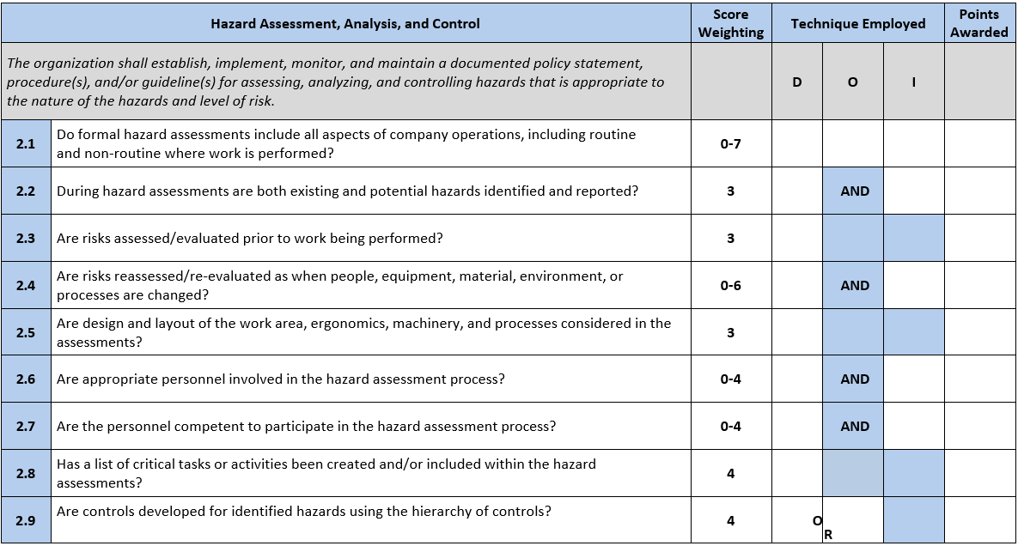
COR® Audit Instrument Scoring Table
Notes:
Interviews

Slide 11
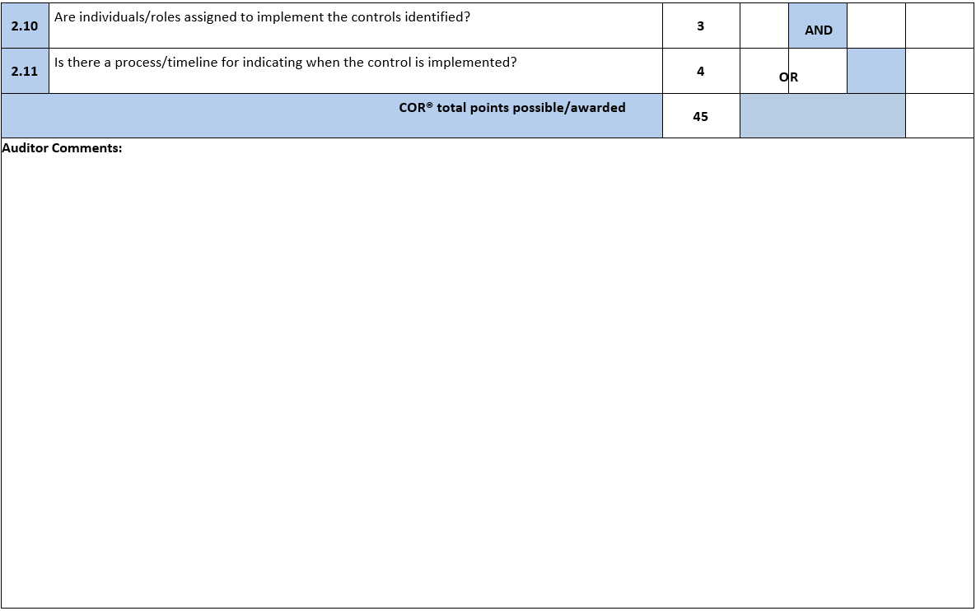
COR® Audit Instrument Design
Notes:
Observations

Slide 12
COR® Audit Instrument Observations Table
Notes:
Observations

Slide 13
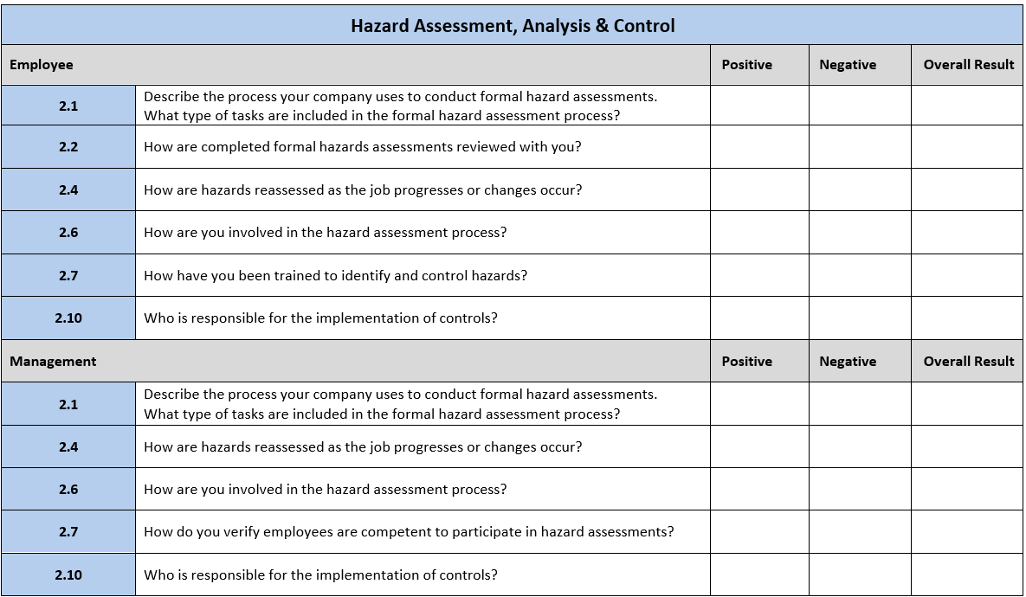
COR® Audit Instrument Interview Table
Notes:
Observations

Slide 14
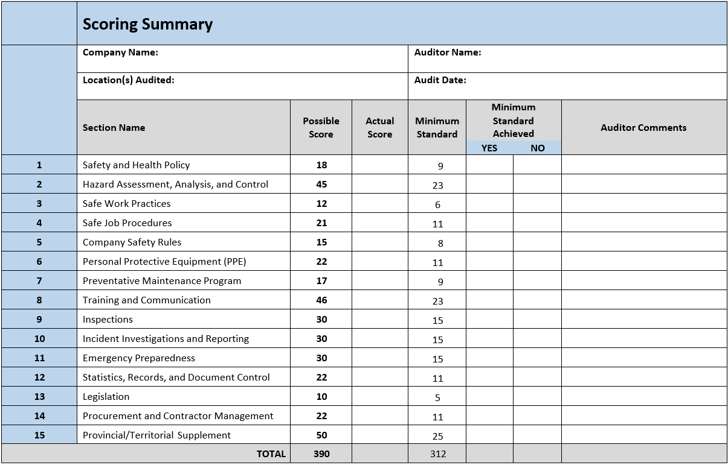

Slide 15
Guidelines, Evidence & Scoring
Source(s) of evidence to be assessed and the weighting of the evidence found in guidelines.
Clear guidelines on scoring for each question.
Types of questions:
All sources of evidence question DOI (partial point scoring)
AND (all or nothing scoring)
AND (partial points scoring)
OR (one source of evidence required to be confirmed)
Single source of evidence question, D/O/I (all or nothing scoring)

Slide 16
COR® Audit Instrument Design
✓
✓
x
5
Guideline:
An employer is required to complete formal hazard assessments that encompass all aspects of company operations, including both routine tasks and non-routine work. Hazard assessments could also include primary scopes of work undertaken by the company, task inventories, or occupational exposures. The hazard assessments should be based on the work performed and should result in the identification of hazards and implementation of control measures.
-Award two (2) points based on documentation of completed formal hazard assessments as per company policy/directive.
- Award three (3) points based on observations that the formal hazard assessments accurately reflect the activities on site and are made readily available.
- Award two (2) points based on the majority of positive interview responses.
Notes:
AND: For most AND question worth less than 4 points both sources of evidence must confirm the question for points to be awarded. Other AND questions, typically 4 or more in value
Will allow partial points based on the type of evidence being assessed. Guidelines will specify. For example, 3 points for D, 2 points for I. Or broken down in on type of evidence. # points for management training, 3 points for employee training
OR: only one source of evidence is required to confirm the question. Full points to be awarded.
Always refer to the question guidelines to ensure the question is scored correctly.

Slide 17
COR® Audit Instrument Design
x
✓
0
Guideline:
Completed hazard assessments must clearly report/describe existing and potential hazards and the majority of interview responses must confirm workers review of the information on hazard assessments. Both documentation and interviews must be confirmed to award points.
Notes:
AND questions
All or nothing score
Look for single value in score weighting column

Slide 18
COR® Audit Instrument Design
✓
3
Guideline:
Completed hazard assessments must show that risks are assessed/evaluated prior to work being performed. An example of an assessment/evaluation could include hazard ranking using frequency, severity, or probability ranking.
Notes:
Single source of evidence questions
ALL or NOTHING (no partial points)

Slide 19
COR® Audit Instrument Design
✓
x
3
Guideline: Documentation must show that risks on hazard assessments are reassessed/re-evaluated when people, equipment, material, environment, or processes are changed. The frequency of this type of assessment will depend on how often changes occur. The hazard assessment commonly used before each day, or each task, is a good example of an ongoing risk assessment process. Award three (3) points based on documentation of completed ongoing risk assessments from the same worksite location as applicable. Award three (3) points based on the majority of positive interview responses
Notes:
AND questions
Partial/range points

Slide 20
COR® Audit Instrument Design
Guideline:
Once hazards are identified, appropriate controls must be put in place. Verify the methods of control follow the hierarchy of controls (elimination, substitution, engineering controls, administrative controls, personal protective equipment). Verify through documentation showing hierarchy of controls was used to determine the appropriate control method. Points may also be awarded by verifying workers are following the controls identified on the hazard assessment for the job/task.
x
✓
4
Notes:
OR questions:
One or both sources must be confirmed to award points (if both confirmed score is the same)

Slide 21
COR® Audit Instrument Design
✓
✓
x
Notes:
Observations

Slide 22
COR® Audit Instrument Design
✓
✓✓✓
N
✓✓✓
✓
P
✓
✓✓✓
P
✓
✓
N
✓✓
P
Notes:
Interview Scoring
50% or more is positive
Some questions are asked to only employees, others only to management. Most questions are asked to both groups.
*When question asked to both management and employees take the total from both groups to determine if P or N

Slide 24
Q & A

Slide 25
Thank you!

