Slide 1
New COR® Standard:
Summary of
Changes
35 MacDonald Avenue
Dartmouth, NS, B3B 1C6

Slide 2
About CSNS
Construction Safety Nova Scotia (CSNS) is an industry funded not-for-profit association focused on improving occupational health and safety in the construction sector.
All companies with a current WCB account under the construction industry classification codes 4011-4499 and 3551 are automatically members due to the levies they pay to the WCB.

Slide 3
Member Benefits
Discounted training (classroom, virtual, online, on-demand at your site)
First year of Certificate of Recognition (COR) evaluation and training FREE!
Free consulting services from our highly-skilled OHS advisors
Downloadable and customizable templates

Slide 4
CONNECT WITH US
1-800-971-3888 or 1 (902) 468-6696
info@constructionsafetyns.ca
Construction Safety Nova Scotia
ConstructionSafetyNS
@ConstrSafetyNS
ConstructionSafetyNS
www.constructionsafetyns.ca

Slide 5
New COR® Standard:
Summary of
Changes
35 MacDonald Avenue
Dartmouth, NS, B3B 1C6

Slide 6
National COR® Accreditation Standard
The National COR® Accreditation Standard approved 2021
The COR® Harmonized Audit Instrument endorsed for use 2022
Most provinces intend to implement The COR® Harmonized Audit Instrument
NB, MB, SK implemented January 1, 2023
General process for completing the audit has not changed.
Many companies have already developed and implemented the policies, practices and procedures detailed in the new COR® Standard.

Slide 7
Benefits of the new COR® standard
Simplifies COR® Certification by
Improving clarity in the language of the audit instrument
Providing clear and detailed scoring guidelines
Making it easier to achieve COR® reciprocity with other provinces and territories
Setting the stage for electronic options to complete COR® audits

Slide 8
Summary of Changes – Improved Clarity
Sections 1 through 13 are asking for very similar information as before but have been re-worded to be consistent across Canada’s Provinces and Territories.
Most changes are the result of wording updates to clearly align with National COR® Accreditation Standard, including :
Simplified question wording
Change in sequence of questions
Change in source of evidence being assessed and the weighting of the evidence
Removal or combining of multiple questions into one question
The addition of “and” & “or” questions
Clear guidelines on scoring of questions and evidence assessed.

Slide 9
CSNS Transition Approach
Sept 2023 Soft Launch
Members have option of a one-time choice in 2023, of using old vs new COR audit instrument
Jan. 1, 2024: Members must begin using audit instrument for new COR®

Slide 10
CSNS Transition Approach
CSNS Advisors and Administrators to help members on individual basis
Scheduled virtual Q & As for members
Webinar covering changes to the COR® Standard
Webinar covering new COR® Audit Instrument
Overview of Instrument
Sources of Evidence (DOI)
Scoring Methodology
Resources available on https://constructionsafetyns.ca/cor-harmonization/
Virtual Instructor Lead Training
Guidance on how to meet new standard requirements to be provided in members’ audit report

Slide 11
New Questions
2.2 | During hazard assessments are both existing and potential hazards identified and reported?
2.3 | Are risks assessed/evaluated prior to work being performed?
2.4 | Are risks reassessed/re-evaluated as when people, equipment, material, environment, or processes are changed?
2.5 | Are design and layout of the work area, ergonomics, machinery, and processes considered in the assessments?
2.7 | Are the personnel competent to participate in the hazard assessment process?
2.9 | Are controls developed for identified hazards using the hierarchy of controls?
2.10 | Are individuals/roles assigned to implement the controls identified?
2.11 | Is there a process/timeline for indicating when the control is implemented?

Slide 12
New Questions
5.1 | Does the policy, procedure, or guideline include responsibilities for setting, implementing, and complying with company rules.
5.2 | Are both company and project (work location) specific rules available?
8.1 | Is there a method for the selection of safety and health training of employees?
8.2 | Is there a method for the evaluation and monitoring of the knowledge, competency, and effectiveness of safety and health training of employees?
8.3 | Have appropriate individuals been trained in legislated requirements?

Slide 13
New Questions
9.4 | Are specific methods, forms, or checklists used to identify deficiencies for pre-use inspections?
9.5 | Are corrective actions assigned to individuals and implemented as specified?
9.6 | Is the required frequency of inspections being met by the supervisor and other responsible individuals?
9.7 | Does the inspection process include participation of all levels within the company?

Slide 14
New Questions
11.2 | Is emergency equipment readily available and well-marked?
11.3 | Is emergency equipment regularly inspected and maintained?
11.11 | Have the emergency procedures and response plans been reviewed, and revised as appropriate, at least annually?
11.12 | Is relevant information regarding the emergency response plans communicated to the appropriate parties?
12.1 | Are approved and current versions of applicable documents readily available at the point of use?
12.4 | Are leading and lagging performance measured?

Slide 15
New Questions
14.1 | Does the company have criteria for the selection, evaluation, and monitoring of contractors and service providers?
14.2 | Does the evaluation, selection, and monitoring include the ability and competency of the contractor to identify, communicate, and control hazards that may impact their own workers, your workers, as well as any other person?
14.3 | Has the criteria for the selection, evaluation, and monitoring of contractors and service providers been followed?
14.4 | Is there a system in place to coordinate safety and health requirements, roles, and responsibilities when multiple contractors/employers are working under your control?
14.5 | Does the company have criteria for the selection, evaluation, and procurement of products that have the potential to create a hazard?
14.6 | Has the criteria for the selection, evaluation, and procurement of products been followed?

Slide 16
New Questions
15.9 | Does a Return-to-Work policy exist?
15.10 | Is there a Return-to-Work program in place?
15.11 | Are the roles and responsibilities defined in the Return-to-Work program?
15.12 | Is company specific Return-to-Work training conducted?
15.13 | Is the Return-to-Work program evaluated for effectiveness?
15.14 | Does the company use initiatives or programs to support or educate workers in mental health and psychosocial hazards?

Slide 17
New Questions
15.9 | Does a Return-to-Work policy exist?
15.10 | Is there a Return-to-Work program in place?
15.11 | Are the roles and responsibilities defined in the Return-to-Work program?
15.12 | Is company specific Return-to-Work training conducted?
15.13 | Is the Return-to-Work program evaluated for effectiveness?
15.14 | Does the company use initiatives or programs to support or educate workers in mental health and psychosocial hazards?

Slide 18
Evidence to Satisfy New Requirements
Guidelines at beginning of each section will detail possible sources of evidence required to satisfy requirements:
2.4 | Documentation must show that risks on hazard assessments are reassessed/re-evaluated when people, equipment, material, environment, or processes are changed. The frequency of this type of assessment will depend on how often changes occur. The hazard assessment commonly used before each day, or each task, is a good example of an ongoing risk assessment process. - Award three (3) points based on documentation of completed ongoing risk assessments from the same worksite location as applicable. - Award three (3) points based on the majority of positive interview responses.
2.5 | Documented hazard assessments must include consideration of design and layout of the work area, ergonomics, machinery, or processes to award points for this section. The risk of musculoskeletal injury and appropriate prevention control (safe job procedures, tailored work schedules, personal protective equipment, etc.) would be an example for awarding points.

Slide 19
COR® Audit Instrument Design
6.0 | Guidelines - Personal Protective Equipment (PPE)
Small Business- All questions apply
6.1 | To determine the criteria used for basic and specialized personal protective equipment (PPE) selection, review hazard assessment forms, safety data sheets, codes of practice, and company PPE policy requirements for reference to CSA or other legislated standards. Confirm employee understanding through the interview process. - Award two (2) points based on documentation to verify the company has established criteria for the selection of protective equipment. - Award two (2) points based on the majority of positive interview responses confirming an understanding of the criteria used for selection of protective equipment.
6.2 | Verify through documentation that the employer has developed and made written instructions readily available to employees with respect to the proper fitting, care, and use of basic and specialized PPE such as: ear plugs, respiratory devices, fall protection, etc.
6.3 | Verify that workers have been made aware of requirements/provided instructions with respect to the proper fitting, care, and use of basic and specialized PPE prior to beginning work. - Award two (2) points based on completed worker orientations and/or training records confirming the review of PPE requirements. - Award two (2) points based on the majority of positive interview responses confirming an understanding of the company's requirements for PPE.
6.4 | Verify that appropriate PPE is provided and/or made available for specific activities. PPE that is required during specific activities may include, but is not limited to, fall protection, respiratory protection, face shields, welding shields/goggles, chemical goggles, fire retardant coveralls, chemical suits, and impermeable gloves. - Award two (2) points based on the observation of appropriate PPE for specific activities is available. - Award two (2) points based on the majority of positive interview responses.
6.5 | Workers should be observed using basic and specialized PPE at all times as prescribed by company criteria, SDS, CSA, or other legislated standards.
6.6 | Basic PPE inspections and maintenance may be conducted and recorded as part of a safety meeting or be included as an item on the company's inspection checklist. Specialized PPE inspections will require verification of pre-use inspection and compliance with manufacturers' recommendations. - Award two (2) points based on supplied documentation that verifies regular inspection and maintenance of PPE. - Award two (2) points based on the observation of PPE should be well maintained, in serviceable condition, and meet regulatory standards.

Slide 20
COR Audit Instrument Design
Personal Protective Equipment (PPE) |  | Score Weighting | Technique Employed |  |  | Points Awarded
The organization shall establish, implement, monitor, and maintain a documented policy statement, procedure(s), and/or guideline(s) for personal protective equipment (PPE). |  |  | D | O | I
6.1 | Are activities requiring PPE documented and is specific criteria used to select appropriate PPE for those activities? | 0-4 |  | AND
6.2 | Are there written rules and/or guidelines for the proper fitting, care, and use of PPE? | 2
6.3 | Are workers made aware of PPE requirements and provided instruction/training for the proper fitting, care, and use of PPE? | 0-4 |  | AND
6.4 | Is appropriate PPE provided and/or made available to workers for specific activities when required? | 0-4 |  | A | ND
6.5 | Is appropriate PPE used by workers as required? | 4
6.6 | Is there a system in place to regularly inspect and maintain PPE? | 0-4 | A | ND
COR® total points possible/awarded |  | 22

Slide 21
COR Audit Instrument Design
Safety and Health Program Verification |  | Score Weighting | Technique Employed |  |  | Points Awarded
6 | Personal Protective Equipment (PPE) |  | D | O | I
 | The organization shall establish, implement, monitor, and maintain a documented policy statement, procedure(s), and/or guideline(s) for personal protective equipment (PPE).
6.1 | Are activities requiring PPE documented and is specific criteria used to select appropriate PPE for those activities? | 4 |  | AND
6.2 | Are there written rules and/or guidelines for the proper fitting, care, and use of PPE? | 2
6.3 | Are workers made aware of PPE requirements and provided instruction/training for the proper fitting, care, and use of PPE? | 4 |  | AND
6.4 | Is appropriate PPE provided and/or made available to workers for specific activities when required? | 4 |  | AN | D
6.5 | Is appropriate PPE used by workers as required? | 4
6.6 | Is there a system in place to regularly inspect and maintain PPE? | 4 | AN | D
COR® total points possible/awarded |  | 22
Guideline: Basic PPE inspections and maintenance may be conducted and recorded as part of a safety meeting or be included as an item on the company’s inspection checklist.
Specialized PPE inspections will require verification of pre-use inspection and compliance with manufacturers’ recommendations.
- Award two (2) points based on supplied documentation that verifies regular inspection and maintenance of PPE.
Award two (2) points based on the observation of PPE should be well maintained, in serviceable condition, and meet regulatory standards
Observation Question: Is PPE well maintained and in good condition, and does it meet regulatory requirements?
Notes:
Separate question in the previous standard assessing basic and specialized PPE now ask for PPE as a category including both basic and specialized.
9 questions are now 6

Slide 22
COR® Audit Instrument Design
Personal Protective Equipment
Do personnel have access to specialized PPE for specific activities?
Is the correct PPE used by personnel when required?
Is PPE well maintained, in good condition and meets regulatory requirements?
Notes:
Observations

Slide 23
COR® Audit Instrument Design
Personal Protective Equipment (PPE)
Employee |  | Positive | Negative | Overall Result
6.1 | How do you know what PPE is required to perform a specific task?
6.3 | What type of training did you receive to understand the proper fitting, care and use of your PPE?
6.4 | How do you have access to appropriate PPE when needed?
Management |  | Positive | Negative | Overall Result
6.1 | What criteria is used to select appropriate PPE for company specific tasks?
6.3 | What type of training is provided to your employees to help them understand the proper fitting, care and use of PPE?
6.4 | How do your employees have access to appropriate PPE when needed?
Notes:
Interviews

Slide 24
Scoring: And, Or & Partial Points
Safety and Health Program Verification |  | Score Weighting | Technique Employed |  |  | Points Awarded
2 | Hazard Assessment, Analysis, and Control |  | D | O | I
 | The organization shall establish, implement, monitor, and maintain a documented policy statement, procedure(s), and/or guideline(s) for assessing, analyzing, and controlling hazards that is appropriate to the nature of the hazards and level of risk.
2.1 | Do formal hazard assessments include all aspects of company operations, including routine and non-routine where work is performed? | 7
2.2 | During hazard assessments are both existing and potential hazards identified and reported? | 3 |  | AND
2.3 | Are risks assessed/evaluated prior to work being performed? | 3
2.4 | Are risks reassessed/re-evaluated as when people, equipment, material, environment, or processes are changed? | 6 |  | AND
2.5 | Are design and layout of the work area, ergonomics, machinery, and processes considered in the assessments? | 3
2.6 | Are appropriate personnel involved in the hazard assessment process? | 4 |  | AND
2.7 | Are the personnel competent to participate in the hazard assessment process? | 4 |  | AND
2.8 | Has a list of critical tasks or activities been created and/or included within the hazard assessments? | 4
2.9 | Are controls developed for identified hazards using the hierarchy of controls? | 4 | O | R
2.10 | Are individuals/roles assigned to implement the controls identified? | 3 |  | AND
2.11 | Is there a process/timeline for indicating when the control is implemented? | 4 | O | R
COR® total points possible/awarded |  | 45
Notes:
AND: For most AND question worth less than 4 points both sources of evidence must confirm the question for points to be awarded. Other AND questions, typically 4 or more in value
Will allow partial points based on the type of evidence being assessed. Guidelines will specify. For example, 3 points for D, 2 points for I. Or broken down in on type of evidence. # points for management training, 3 points for employee training
OR: only one source of evidence is required to confirm the question. Full points to be awarded.
Always refer to the question guidelines to ensure the question is scored correctly.

Slide 25
Scoring: And, Or & Partial Points
Safety and Health Program Verification |  | Score Weighting | Technique Employed |  |  | Points Awarded
2 | Hazard Assessment, Analysis, and Control |  | D | O | I
 | The organization shall establish, implement, monitor, and maintain a documented policy statement, procedure(s), and/or guideline(s) for assessing, analyzing, and controlling hazards that is appropriate to the nature of the hazards and level of risk.
2.1 | Do formal hazard assessments include all aspects of company operations, including routine and non-routine where work is performed? | 7 | ✓ | ✓ | x | 5
2.2 | During hazard assessments are both existing and potential hazards identified and reported? | 3 |  | AND
2.3 | Are risks assessed/evaluated prior to work being performed? | 3
2.4 | Are risks reassessed/re-evaluated as when people, equipment, material, environment, or processes are changed? | 6 |  | AND
2.5 | Are design and layout of the work area, ergonomics, machinery, and processes considered in the assessments? | 3
2.6 | Are appropriate personnel involved in the hazard assessment process? | 4 |  | AND
2.7 | Are the personnel competent to participate in the hazard assessment process? | 4 |  | AND
2.8 | Has a list of critical tasks or activities been created and/or included within the hazard assessments? | 4
2.9 | Are controls developed for identified hazards using the hierarchy of controls? | 4 | O | R
2.10 | Are individuals/roles assigned to implement the controls identified? | 3 |  | AND
2.11 | Is there a process/timeline for indicating when the control is implemented? | 4 | O | R
COR® total points possible/awarded |  | 45
Notes:
Partial points may be awarded. The guidelines will specify how to allocate the points for each source of evidence being assessed.

Slide 26
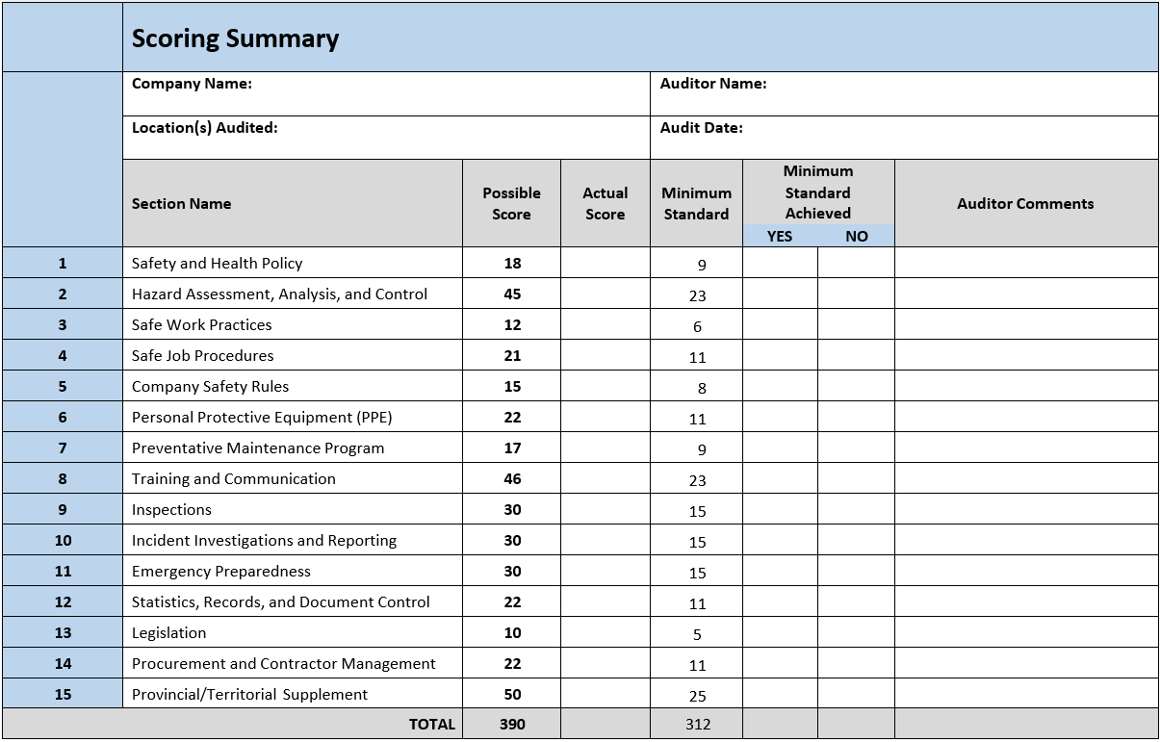

Slide 27
Q & A

Slide 28
Thank you!

